Slide 1
Excel shortcut keys and formulas
QUICK-REFERENCE CHEAT SHEET
=SUM(
Shortcuts, marksheet logic, lookups, text, dates and finance

Slide 2

Excel shortcut keys
KEYBOARD
Move between sheets, fill a series, and total a range
Ctrl + Shift + ↑
Change sheets (press the up or down key on the num pad)
Ctrl + Tab
Change workbook
Alt + Enter
Write on a new line inside one cell
Alt + E + I + S and Alt + H + F + I + S
Open Series to fill columns or rows
Total a range
Write =SUM, press Tab, select the rows or columns, then press Enter
Select entire row or column
In the Name Box enter the cell, then press Enter while holding Shift
Excel shortcut keys and formulas · 2

Slide 3

Marksheet formulas and shortcuts
MARKSHEET
Random marks, min and max, average, and a pass or fail check (MARKS SHEET)
Autofit cells
Right-click the sheet tab, View Code, select Worksheet, write Cells.EntireColumn.AutoFit
Random numbers
=RANDBETWEEN, Tab, then select numbers
Min / Max
=MIN or =MAX, Tab, then select the range
Fix the numbers
=RANDBETWEEN(33,100), then Ctrl + D, Ctrl + R, Ctrl + C, Alt + H + V + V
Average
= select total, type /, divide by the total number of subjects
Whole column
=SUM/MIN/MAX, Tab, select the first row only, Enter, then Ctrl + D
Result per subject
=IF(AND(D3>=33,E3>=33,F3>=33,G3>=33,H3>=33,I3>=33,J3>=33),"pass","fail") (D3, E3 and so on are the subjects)
Excel shortcut keys and formulas · 3

Slide 4
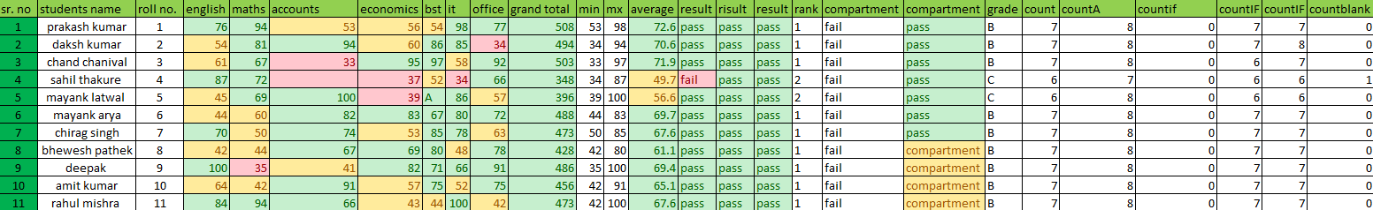
Marksheet result, rank, and compartment
MARKSHEET
Pass or fail from total and percent, then rank and compartment
Result from total
Write =IF(, select the total, >, the marks a student needs to pass, then ,"pass","fail"). Example: =IF(K3>100,"pass","fail")
Result from %
=IF(N7>33,"pass","fail"). Write =IF(, select the average, >, the percentage a student needs to pass, then ,"pass","fail")
Rank using average
=IF(N2>60,"1",IF(N2>40,"2",IF(N2<33,"3")))
Rank using RANK
=RANK(N2,N$2:N$12,0) (written as N2:N2:N12 in the original)
Compartment
=IF(N2>=7,"pass",IF(N2>=2,"compartment","fail"))
Compartment, COUNTIF
=IF(COUNTIF(C3:J3,">100")=5,"pass",IF(COUNTIF(C3:J3,"<100")>=3,"fail","compartment"))
Excel shortcut keys and formulas · 4

Slide 5
Editing, counting and discount
EDITING
Merge rows or columns
select, then Alt + H + M + C
COUNTIF less than 33
=COUNTIF(first row of subjects,"<33")
Insert border
Alt + H + B
COUNTIF greater than 33
=COUNTIF(first row of subjects,">33")
Insert rows and columns
Ctrl + Shift + +
COUNTIF equals to 33
=COUNTIF(first row of subjects,">=33")
Delete rows and columns
Ctrl + Shift + -
Empty cells
=COUNTBLANK(select the range)
Edit tables
select cells, then Ctrl + T
Change sheet name
Alt + H + O + R
Calculate amount
=price*quantity
Calculate discount
=amount*discount% (same for GST)
Put in each column
Alt + A + E, then Enter three times
Jump to a filled cell
Ctrl + ↑ / ↓
Count items
=COUNT( select every row, Enter; same for COUNTA
Excel shortcut keys and formulas · 5

Slide 6
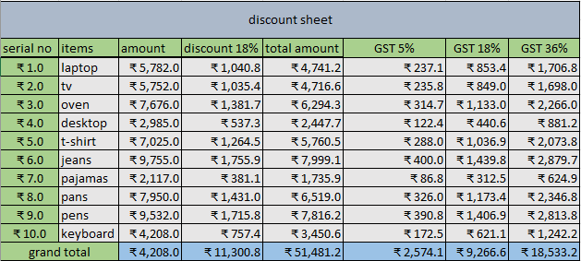
Discount sheet
EXAMPLE
Excel shortcut keys and formulas · 6

Slide 7
Flash fill and text to columns
FILL
Flash fill
Fills columns quickly with Ctrl + E: write data from one column into each item in different cells. To write them together again use =CONCATENATE( and select each item one by one with a comma after each.
Text to columns
Works like flash fill, but needs a space between items. Press Alt + A + E, Enter, select Space in the menu, then Enter twice.
Email | Name | No. | @ | Domain | Joined
Tushar01@gmail.com | Tushar | 1 | @ | Gmail.com | Tushar1@gmail.com
Sahil01@gmail.com | Sahil | 1 | @ | Gmail.com | Sahil1@gmail.com
Prakash01@gmail.com | Prakash | 1 | @ | Gmail.com | Prakash1@gmail.com
Chirag01@gmail.com | Chirag | 1 | @ | Gmail.com | Chirag1@gmail.com
Aarav01@gmail.com | Aarav | 1 | @ | Gmail.com | Aarav1@gmail.com
Vivaan01@gmail.com | Vivaan | 1 | @ | Gmail.com | Vivaan1@gmail.com
Aditya01@gmail.com | Aditya | 1 | @ | Gmail.com | Aditya1@gmail.com
Excel shortcut keys and formulas · 7

Slide 8
PMT, IPMT and PPMT
FINANCE
PMT (fixed payment)
Finds the EMI amount: =PMT(interest rate/12,total number of months,-loan amount)
IPMT (interest portion)
Finds the interest on a loan: =IPMT(interest rate/12,1,total number of months,-loan amount)
PPMT (principal portion)
Finds the principal amount: =PPMT(interest rate/12,1,total number of months,-loan amount)
Excel shortcut keys and formulas · 8

Slide 9
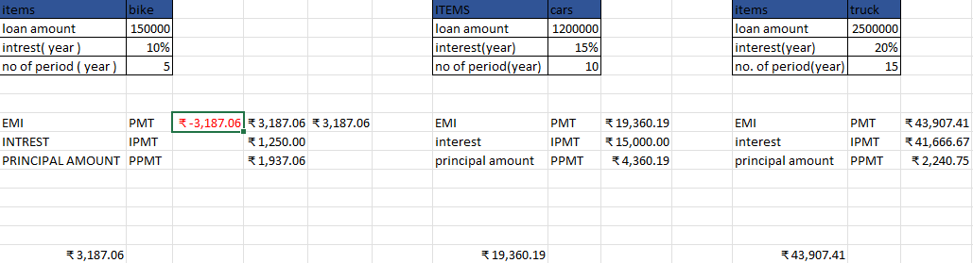
Loan sheet: EMI, interest and principal
EXAMPLE
Excel shortcut keys and formulas · 9

Slide 10
Product sheet, sales sheet and text formulas
FORMULAS
Product sheet
Total for one state: =SUMPRODUCT(quantities,amounts,--(states="state name")). Ctrl + D can't be used.
Sales sheet
Total sale: =SUMIF(months,"month name",sales). Ctrl + D can't be used.
LEFT
=left(text,number of letters)
PROPER
=proper(text)
RIGHT
=right(text,number of letters)
CONCAT
=concat( select the texts to join
MID
=mid(text,position of letter)
TEXTJOIN
=textjoin(
LEN
=len(text)
TEXT
=text(
TRIM
=trim(text) removes extra space between words
FIND
=find(
UPPER
=upper(text)
SEARCH
=search(
LOWER
=lower(text)
Excel shortcut keys and formulas · 10

Slide 11
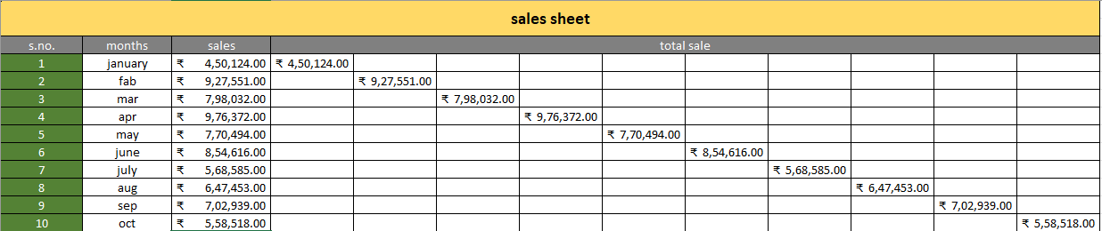
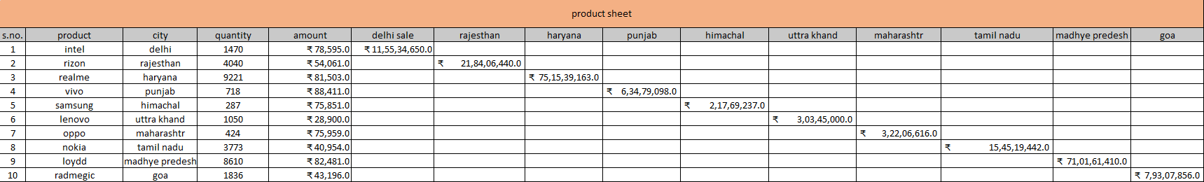
Sales sheet and product sheet
EXAMPLE
Excel shortcut keys and formulas · 11

Slide 12
Age, gender title and consolidate
FORMULAS
Age
=INT(YEARFRAC(DOB,current date))
 | Name | Gender | Title
 | Aarav | M | Mr. Aarav
6 | Naina | F | Ms. Naina
7 | Aditya | M | Mr. Aditya
8 | Komal | M | Mr. Komal
9 | Krishna | F | Ms. Krishna
Title by gender, as written
Male =IF(C3="male","ms."&C3,"mr."&B3) Female =IF(C10="male","mr."&C10,"ms."&B10). Ctrl + D can't be used.
Title by gender, corrected
=IF(C3="male","Mr. "&B3,"Ms. "&B3)
Consolidate
To integrate data in one place: select the main table where all data should go, open Data › Consolidate, select each range and add it, then Enter.
Excel shortcut keys and formulas · 12

Slide 13
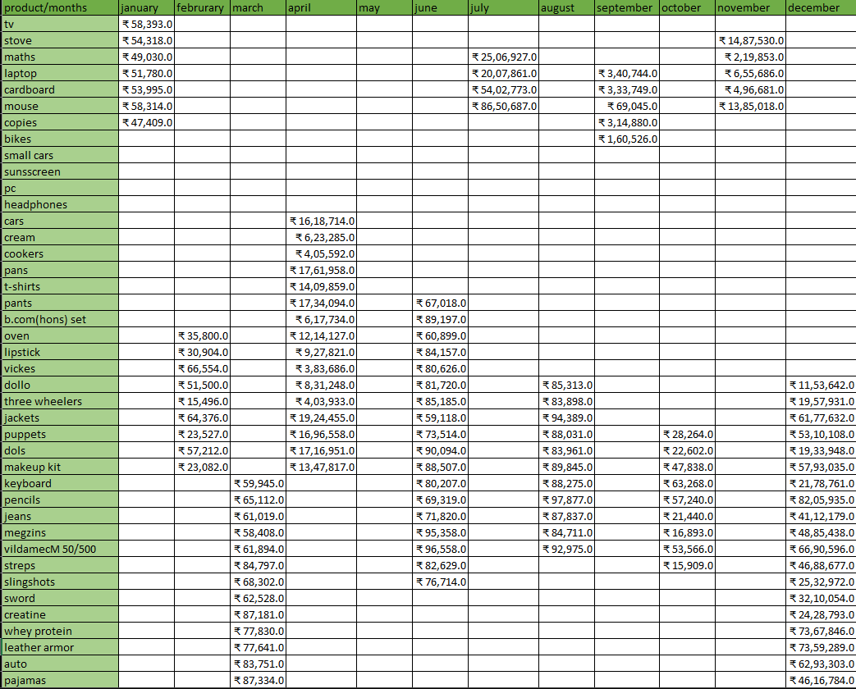
Consolidate example
EXAMPLE
Excel shortcut keys and formulas · 13

Slide 14

Salary slip
PAYROLL
HRA
House rent allowance, on basic salary
LDA
Leave deduction: =basic salary/total working days in a month*LD
DA
Dearness allowance, on basic salary
LTA
Leave travel allowance, on basic salary
OT
Overtime
OTA
=basic salary/24/8*OT (24 hours in a day, 8 working hours)
PF
Provident fund, on total salary
ESI
On total salary
Net salary
=total salary-PF-ESI-LDA+OTA
LD
Leave days
Gross salary
=net salary*12
Tax
=gross salary*tax rate%
This Photo by Unknown Author is licensed under CC BY-NC-ND
Excel shortcut keys and formulas · 14

Slide 15
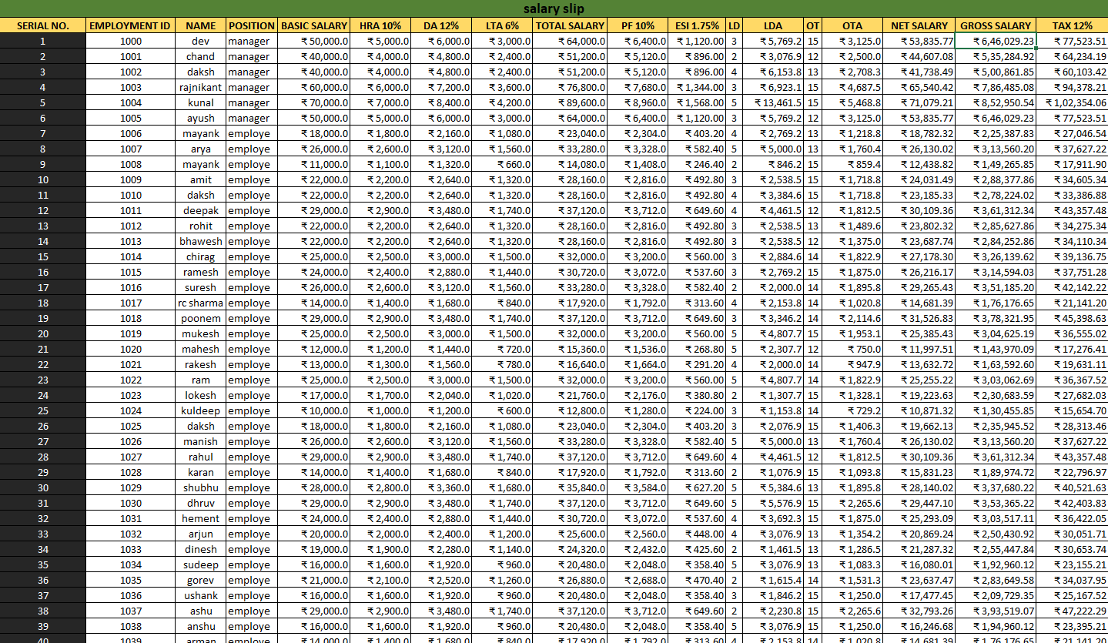
Salary slip sheet
EXAMPLE
Excel shortcut keys and formulas · 15

Slide 16
Data validation, VLOOKUP and HLOOKUP
DATA
Data validation
Data › Data Validation, choose List in the first box, select all product names as the source, then Enter. Ctrl + D can be used.
SUMIF on the list
=SUMIF(select whole table,validated cell,select whole amount) for example =SUMIF(A3:C10,J5,C3:C10)
VLOOKUP
Looks up data down a column: =VLOOKUP(unique id,whole table,column number,0/1) for example =VLOOKUP(M15,A1:J51,4,0)
HLOOKUP
Looks up data across a row: =HLOOKUP(value,whole table,row number,0/1) for example =HLOOKUP(G2,A2:J51,3,0)
Excel shortcut keys and formulas · 16

Slide 17
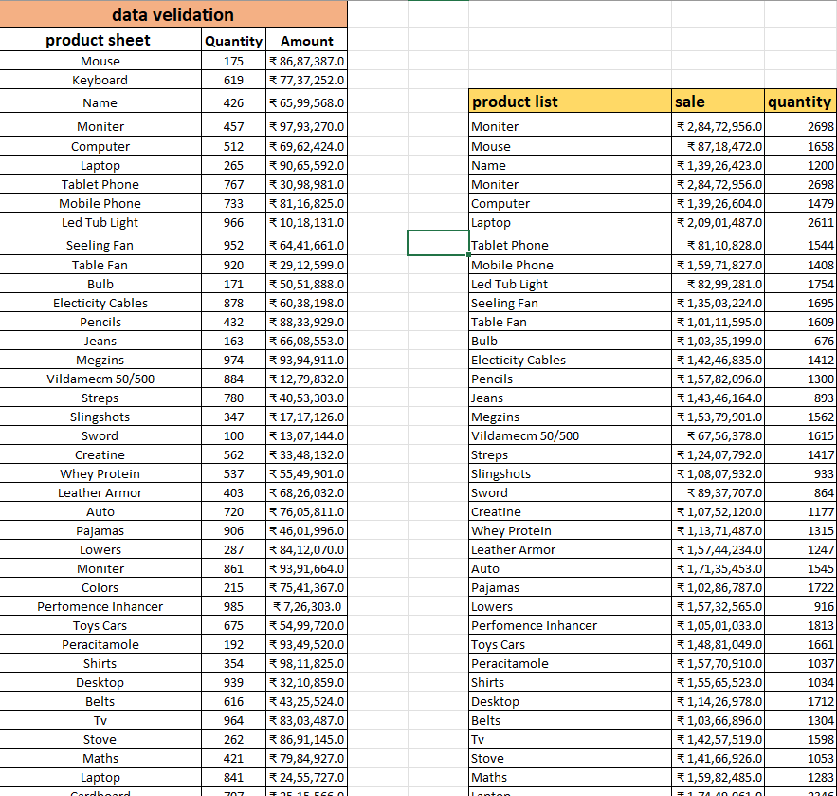
Data validation sheet
EXAMPLE
Excel shortcut keys and formulas · 17

Slide 18
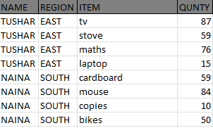
Sort by and Alt + D + O
DATA
Fill empty cells fast
Custom sort: select the whole table, Ctrl + G, click Special, select Blanks, then Enter. It fills each blank with the data just above it.
Alt + D + O
Write a format, do the first entry, select all, press Alt + D + O, then do the entries.
Excel shortcut keys and formulas · 18

Slide 19
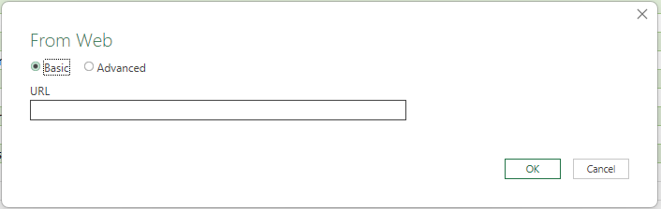
From web
DATA
You can get data from online sources: just enter the exact URL of the website.
Excel shortcut keys and formulas · 19

Slide 20
Connections and quick tools
DATA
Existing connections
When you get data from an online source, Excel keeps a connection to that website, so you can click this option and get the data directly without entering anything.
Subtotal
Shows the sum total of the selected columns.
Remove duplicates
Removes repeated data: select the columns that have duplicate items.
Ctrl + Shift + L
Filter data.
Ctrl + Shift + N
Create a new folder. To save it without a name hold Alt, write 255, then Enter.
Alt + H + O + I
Set cells.
Proper and trim
=PROPER(TRIM(text)). You can combine others the same way.
Excel shortcut keys and formulas · 20

Slide 21
Date, time and lookup formulas
DATES
Today / Now
=TODAY() =NOW()
Date
=DATE(year,month,day)
Time
=TIME(hour,minute,second)
Weekday
=WEEKDAY(serial_number,[return_type]) select a date to see which day it is
Datevalue
=DATEVALUE(date_text) write the date as text
Edate
=EDATE(start_date,months) adds months and shows the exact day
Eomonth
=EOMONTH(start_date,months) adds months and shows the last day of the month
DB
=DB(cost,salvage,life,period,[month]) depreciation with the fixed declining balance (WDV) method
Xlookup
=XLOOKUP(value,unique column,rest of the information)
Excel shortcut keys and formulas · 21

Slide 22
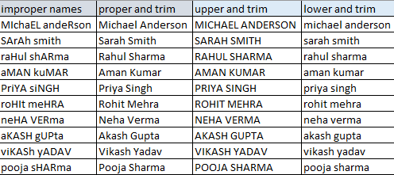
PROPER, LOWER and UPPER with TRIM
TEXT
Proper and trim
=PROPER(TRIM(A2))
Upper and trim
=UPPER(TRIM(A2))
Lower and trim
=LOWER(TRIM(A2))
Excel shortcut keys and formulas · 22

Slide 23
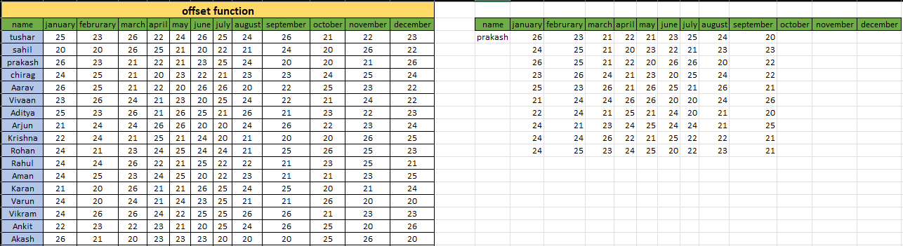
Offset
LOOKUP
=OFFSET(reference,MATCH(value,array,0),1,height,width)
Example: =OFFSET(A2,MATCH(O3,A3:A52,0),1,2,12)
Excel shortcut keys and formulas · 23

Slide 24
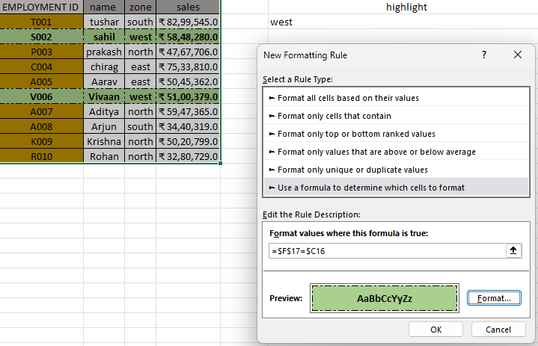
Random letters and conditional formatting
FORMATTING
Random letters
=IF(RANDBETWEEN(1,10)<=7,"P","R")
Conditional formatting
Select the whole table, open New Rule, choose the last option, edit the rule description: select the cell to format from, type =, select what to format (you can also change the formatting), press F4 twice, then Enter.
Excel shortcut keys and formulas · 24

Slide 25
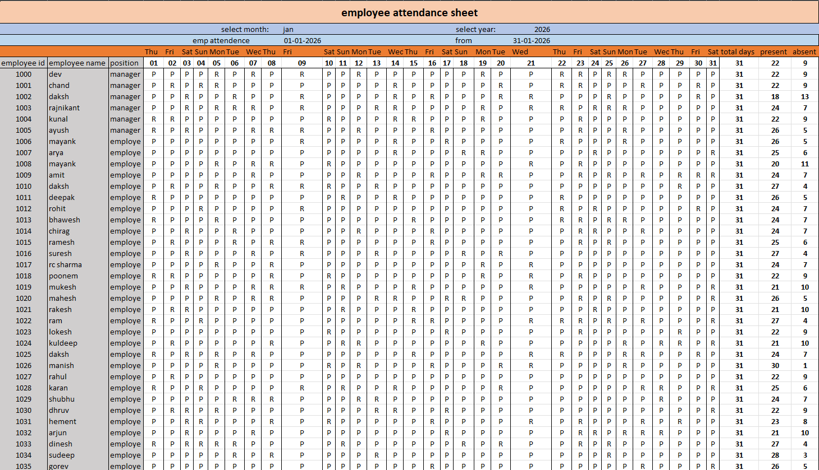
Employee attendance sheet
EXAMPLE
Excel shortcut keys and formulas · 25

